Slide 1

Game Engine Architecture Semester 1 - Presentation
Luke Dicken - Jones
U1752044

Slide 2

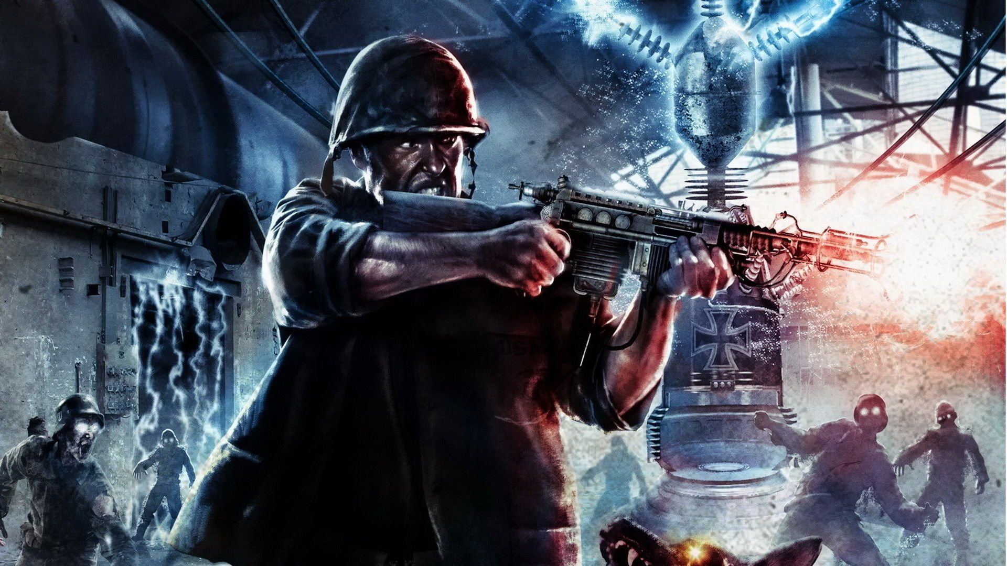

Game Concept
This game’s mechanics are inspired by those found in the Call of Duty: Zombies franchise, where the player’s goal is to survive as many waves of enemies charging towards them as possible. The number of enemies increases with each new wave, therefore the difficulty level progressively increases.
Enemies spawn at random locations in the level each wave, and the player must survive until a ‘Nuke’ powerup spawns in the level, which when collected will destroy all enemies present and initiate the next wave.
The player has a limited amount of health. Enemies inflict damage upon collision with the player, so the player must avoid them if they are to reach higher waves.
The visuals incorporate the retrowave aesthetic, which increases the visibility of certain aspects of the game.

Slide 3

AI Enemies
There are three enemy types:
Standard (medium speed, medium damage)
Tank (slower speed, high damage)
Speedy (faster speed, low damage)
The AI aspect of these enemies influences the steering and throttle values of the enemy vehicles in order to guide them to the player as effectively as possible.
The AI extracts information from the level’s NavMesh to determine a series of points for the enemy to follow in order to avoid obstacles, minimising its risk of becoming ‘stuck’.
In circumstances where the enemy does get ‘stuck’, it is capable of performing a reversal manoeuvre in an attempt to free itself.

Slide 4
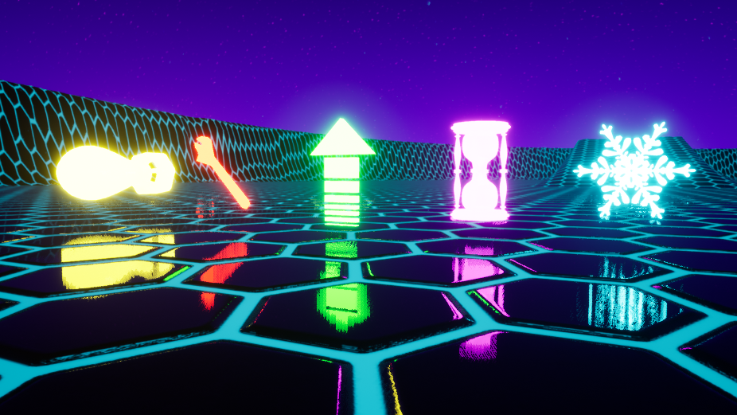
Powerups
There are five powerup types:
Nuke - Destroys all enemies present in the level.
Health Boost - Increases the player’s health by a configurable amount.
Speed boost - Applies a configurable amount of forward force to the player.
Slomo - Modifies the time dilation by a configurable amount for a configurable amount of time, also applies post-processing effects during this time.
Freeze - Applies a very high amount of angular and linear damping to all enemies present simulating them being ‘frozen’ for a configurable amount of time, also applies a post-processing effect during this time.
All powerups inherit from a ‘Powerup’ class, where basic properties such as the capsule component (used for collisions) are set up.
Powerups are set to spin and float up and down endlessly to increase their visibility to the player.

Slide 5
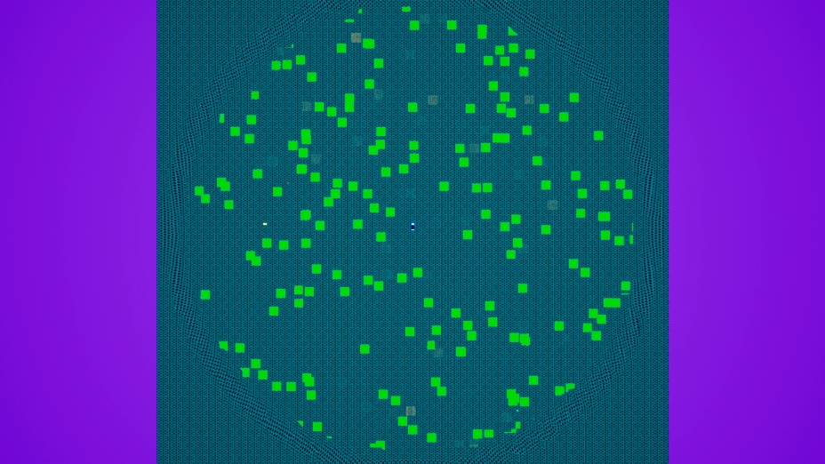
Game Management
The game mode class manages all information related to the game loop
Some examples:
The current wave
The enemies present in the level
The wave gap between the spawning of certain enemy types
What percentage of the enemies in the level are certain enemy types
The maximum number of powerups (nukes treated independently)
Values that influence how long it takes powerups to spawn in (nukes treated independently)
The class also manages the spawning of enemies and powerups. To achieve this, it utilises the level’s NavMesh to determine acceptable locations for enemies and powerups to be spawned
It also provides some of the UI with information and functionality:
HUD information (the current wave, enemy count, and nuke count)
Pausing the game
Ending the game
A debugging demonstration that visualises a random selection of points on the NavMesh for enemy/powerup spawning, generated in the game mode class

Slide 6
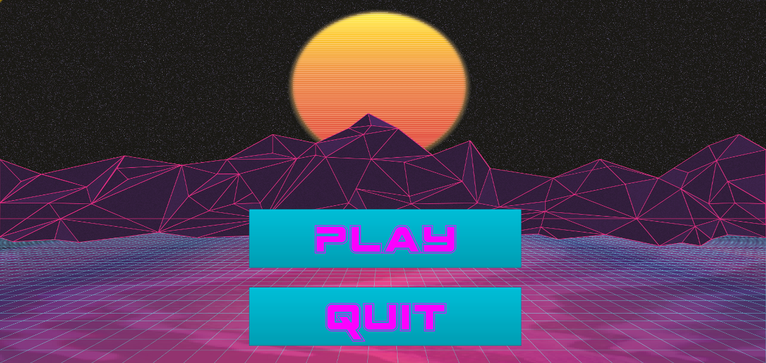


UI (part 1)
Menus:
There are three menu screens:
Main menu - Separate level
Pause menu (‘P’ to activate) - Overlay
Game over menu - Overlay
All menus use ‘Unreal Motion Graphics UI Designer’ (UMG) to control what and where their UI elements are.
Some of their functionality is provided by blueprints, and some comes from the game mode class.

Slide 7
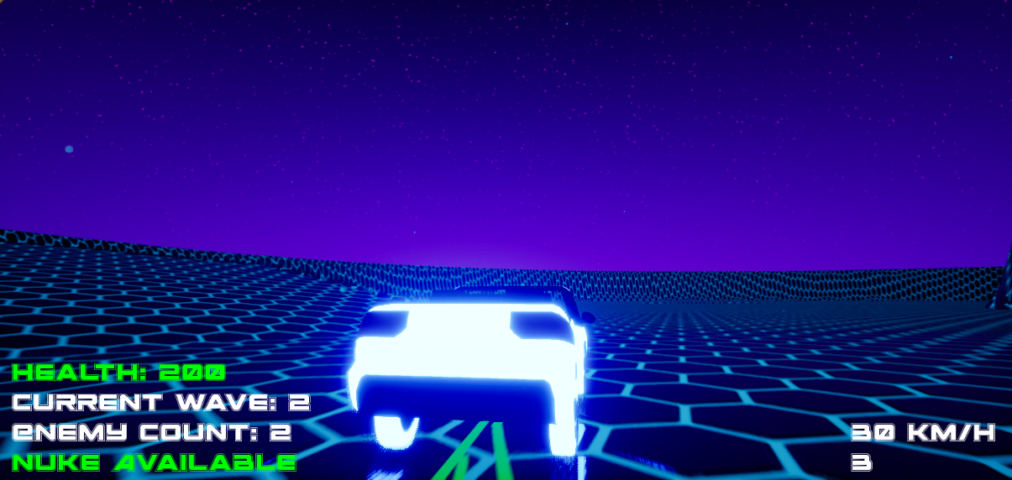

UI (part 2)
HUD:
An expansion of the existing VehicleTemplate HUD class.
The information being displayed is retrieved from the game mode class.
Cursor:
A custom cursor is used by the menus.
Both blueprints and the game mode class are used to set it up, with a method in the game mode class centring it when necessary.

Slide 8
Audio
Music:
Two looping audio cues set up, one for the main menu and one for the level itself.
Sound Effects:
Sound effects are played at the location of certain events in the level (for example, a powerup being spawned/collected).
The closer the player is to the sound, the louder the sound becomes.

Slide 9
Miscellaneous
The map was designed to showcase the AI’s ability to navigate, with various obstacles that can come between the enemies and the player that the AI has to avoid.
The player camera was adjusted to make it a true third person camera. The player has control over the spring arm’s pitch and yaw values using the mouse, with the roll value being kept level to avoid potential motion sickness.
Pressing ‘E’ will reset the pitch and/or roll values of the player’s vehicle if these values indicate that the vehicle is upside-down. This is to ensure the player can still play the game if they were to accidently flip their vehicle.
Particle systems have been used to put emphasis on certain events. For example, when a powerup is collected, or when an enemy is destroyed.

